Slide 1


PROJECT REPORT ON
DIABETA
ML-BASED PREDICTION SYSTEM
NAME | ROLL NO.
VEERTA SHRIVASTAVA | 23118108
SWARA MANDALE | 23118102
NIDHI SAHU | 23118070
CHANDRAKANT VERMA | 23118024

Slide 2




CERTIFICATE OF COMPLETION:

Slide 3
TABLE OF CONTENT
ABOUT THE COURSE
MODEL SELECTION
1.
7.
INTRODUCTION
TRAINING MODEL
2.
8.
TECHNICAL STACK
CORRELATION ANALYSIS
3.
9.
DATA OVERVIEW
MODEL EVALUATION
4.
10.
DATA PREPROCESSING
CONCLUSION
5.
11.
INSIGHTS
POWERBI
6.
12.

Slide 4
About the Course – Applied Data Analytics
• THE CEC CERTIFICATION COURSE ON “APPLIED DATA ANALYTICS: A PRACTICAL APPROACH” WAS ORGANIZED BY THE DEPARTMENT OF INFORMATION TECHNOLOGY, NIT RAIPUR, UNDER THE CONTINUING EDUCATION CELL (CEC).
• THE COURSE WAS CONDUCTED FROM 26TH MAY TO 9TH JUNE 2025, FOCUSING ON PRACTICAL APPLICATIONS OF DATA ANALYTICS AND MACHINE LEARNING.
• IT PROVIDED PARTICIPANTS WITH HANDS-ON EXPERIENCE IN DATA PREPROCESSING, VISUALIZATION, MODEL BUILDING, AND EVALUATION USING MODERN ANALYTICAL TOOLS.
• THE COURSE EMPHASIZED BRIDGING THEORETICAL CONCEPTS WITH REAL-WORLD PROBLEM SOLVING, ENCOURAGING PARTICIPANTS TO APPLY ANALYTICAL THINKING IN DOMAINS SUCH AS HEALTHCARE, BUSINESS, AND RESEARCH.
• THIS PROJECT, “DIABETES PREDICTION USING MACHINE LEARNING,” WAS DEVELOPED AS PART OF THE COURSE TO DEMONSTRATE PRACTICAL IMPLEMENTATION OF LEARNED TECHNIQUES

Slide 5
Introduction​
Problem Statement:​
Diabetes is a chronic disease affecting millions worldwide. Early detection is crucial to prevent complications and manage the condition effectively.​
​
Why We Chose This Topic:​
Diabetes is a growing global health concern, and we wanted to explore how data-driven approaches can assist in early detection and intervention using machine learning.​
​
Objective:​
Develop a predictive model to determine the likelihood of a patient having diabetes based on medical diagnostic measurements.​
​
Dataset:​
We used the Pima Indians Diabetes Dataset, a widely used benchmark dataset for binary classification problems in healthcare analytics.​

Slide 6
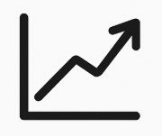





Tech Stack
Machine Learning Libraries:
Pandas, NumPy, Matplotlib, Seaborn
Algorithms: Logistic Regression, Decision Tree, Random Forest, SVM
Visualization:
Power BI (for interactive dashboards and analytics)

Slide 7
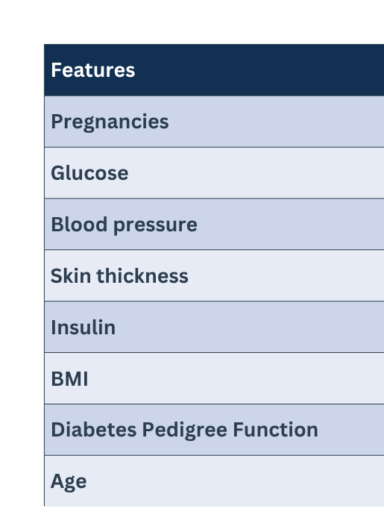
Data Overview
Total Records: 768​
Features: 8​
Target Variable: 0 = Non diabetic​,1 = Diabetic​

Slide 8
Data Preprocessing​
Handling Missing Values:​
Certain features had zero values, which are not physiologically plausible. These were treated as missing and imputed with the median of respective columns.​
Features Imputed:​
Glucose​
Blood Pressure​
Skin Thickness​
Insulin​
BMI​
Standardization:​
Applied Standard Scaler to normalize feature values, ensuring each has a mean of 0 and standard deviation of 1. This step is crucial for algorithms sensitive to feature scaling.​
Data Splitting:​
Divided the dataset into training and testing sets using an 80/20 split:​
Training Set: 614 records​
Testing Set: 154 records​

Slide 9
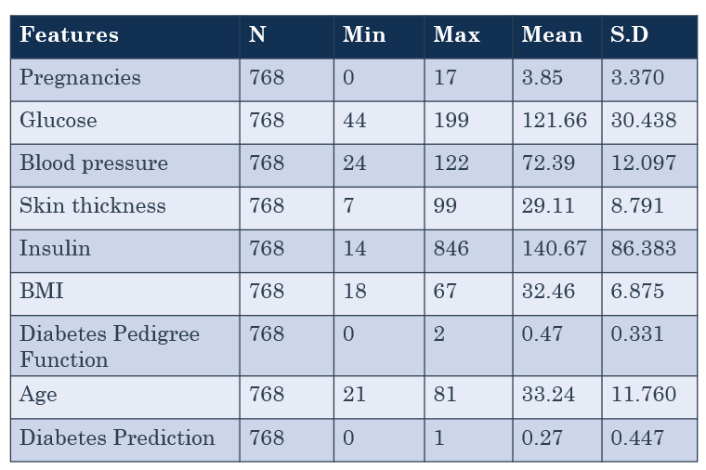
Data Preprocessing​

Slide 10
Insights​
The dataset is imbalanced in terms of diabetes prediction (only 27%positive).​
Health indicators like glucose, BMI, and insulin show wide variability, suggesting a mix of healthy and high-risk individuals.​
Variables such as insulin and skin thickness may have skewed distributions due to high maximum values.​
Mean BMI being in the obese range aligns with the relatively high diabetes rate.​

Slide 11
Model Selection​
Why Random Forest?
Random Forest is an ensemble algorithm that combines multiple decision trees for higher accuracy.
It reduces overfitting and improves generalization across diverse medical data.
Ideal for binary classification tasks like diabetes prediction (0 = Non-Diabetic, 1 = Diabetic).
Provides feature importance, helping identify key health factors influencing diabetes.
Offers better accuracy, robustness, and non-linear handling than Logistic Regression.
Selected as the final model for its reliable and stable performance

Slide 12
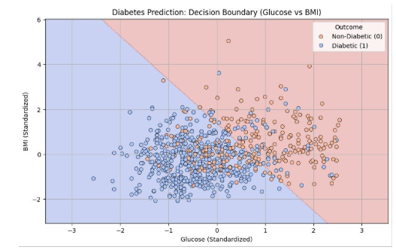
Training the model​
The Random Forest model learns patterns by building multiple decision trees using different subsets of the data and features.
Each tree makes an independent prediction, and the final output is decided by majority voting among all trees

Slide 13
Correlation Analysis
Pregnancies & Age: 0.544 – Older women tend to have had morepregnancies.​
Skin Thickness & BMI: 0.543 – Logical, as higher BMI often corresponds tomore fat under the skin.​
Glucose & Insulin: 0.419– Elevated glucose often corresponds with elevatedinsulin due to insulin resistance.​
BMI & Blood Pressure: 0.281 – Obesity increases blood pressure.​
Weak or Non-significant Correlations:​
Insulin & Blood Pressure: 0.045 – Weak and not significant.​
Pregnancies & Insulin: 0.025 – Very weak.​
Age & BMI: 0.026 – Virtually no relationship.​
Diabetes Pedigree Function & Age: 0.034 – Insignificant.​

Slide 14
Correlation Analysis Conclusion​
Glucose is the strongest individual predictor of diabetes in this dataset.​
BMI, age, insulin, and skin thickness also play moderate roles.​
All predictors except insulin and pedigree function show positive and statistically significant correlations with diabetes.​
The predictors are not highly collinear, which is good for regression modelling.

Slide 15
Model Evaluation​
1.Basic Metrics​
TP = 38
TN = 81​
FP = 19
FN = 16​
Total samples = 88 + 12 + 28 + 26 = 154​
2. Accuracy​
Accuracy = (TP + TN) / Total = (38 + 81) / 154 = 77.3%​
​
3. Precision (for class 1)​
Precision = TP / (TP + FP) = 38/ (38 + 19) = 66.7%​
​
4. Recall (Sensitivity, for class 1)​
Recall = TP / (TP + FN) = 38/ (38 + 16) = 70.4%​
5. F1 Score (for class 1)​
F1 = (2 * Precision * Recall) / (Precision + Recall) = 68.4%

Slide 16
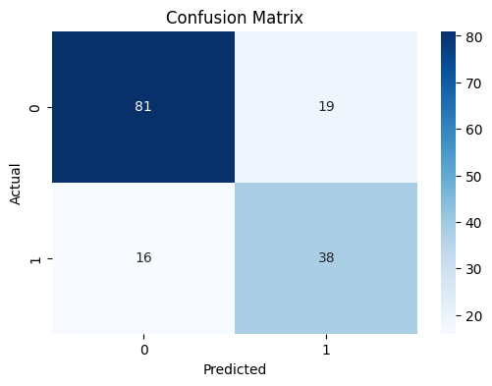
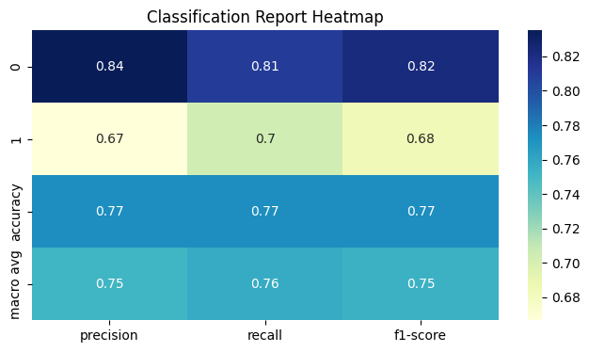
Model Evaluation
Confusion Matrix
Heatmap
Class 0: True Negatives(TN) and False Positives(FP)​
Class 1: False Negatives (FN) and True Positives (TP)​

Slide 17
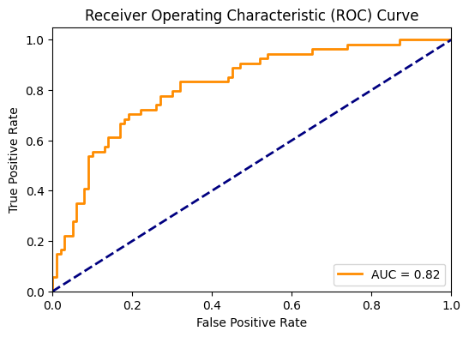
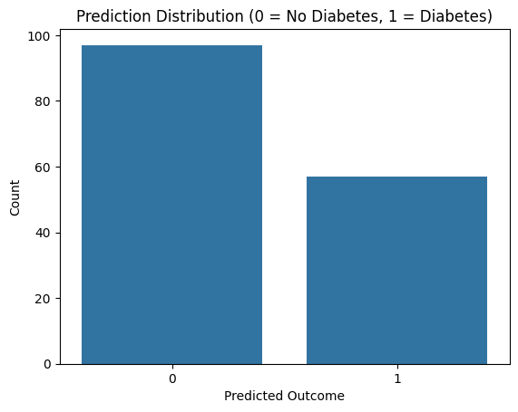
Model Evaluation
ROC Curve
Prediction Distribution
AUC (Area Under the Curve) = 0.82
​
AUC values range from 0.5 (random) to 1.0 (perfect).​
An AUC of 0.81 is considered good, indicating the model has a strongability to distinguish between the two classes

Slide 18
Conclusion:
Most Predictive Features
Glucose, BMI, and Age were the most influential factors in predicting diabetes.
Higher glucose levels significantly increased the likelihood of being diabetic.
The model also showed meaningful contributions from Insulin and Blood Pressure in certain cases.
Model Characteristics
It effectively captured non-linear relationships between medical features and diabetes outcomes.
Achieved an AUC of 0.81, indicating strong separability between diabetic and non-diabetic patients.
The model offered high interpretability through feature importance rankings and consistent prediction performance.

Slide 19
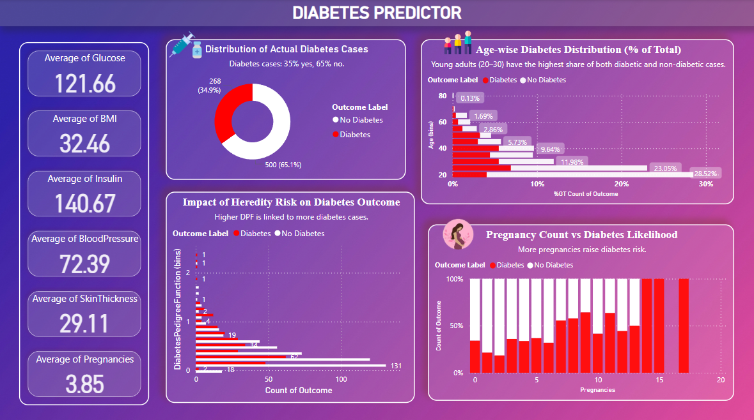

Slide 20
